Slide 1
GROUP-1
VOICE TO VOICE: RECOGNITION AND RESPONSE SYNTHESISER
presented by:
Naeem Hadiq (4)
Neha Parveen (6)
Nibras Nazar (7)
Sumeena Salam (50)
Guided by:
Dr. Sobin C. C.
Associate Professor
Department of Computer Science and Engineering

Slide 2
Introduction
Create an offline(Low Inference Compute) Vocal recognition and response system capable of understanding user input including the context and tones of speech.
The system can be used as critical responses for Computer controlled devices and systems including robots and war equipments.

Slide 3
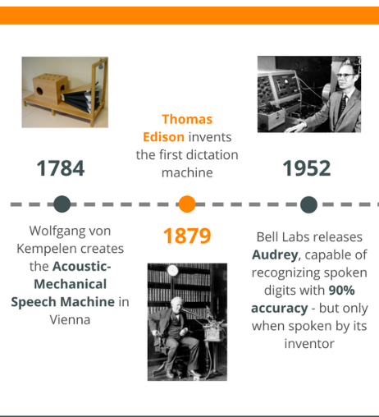
History

Slide 4
Evolution
At the Seattle World’s Fair in 1962, IBM presented a tool called Shoebox. It was the size of a shoebox and could perform mathematical functions and recognize 16 spoken words as well as digits 0-9.
In the 1970s, scientists at Carnegie Mellon University in Pittsburgh, Pennsylvania created Harpy. It could recognize 1,011 words, which is about the vocabulary of a three-year-old.
The Julie doll from the Worlds of Wonder toy company came out in 1987 and could recognize a child’s voice and respond to it.
Apple began building speech recognition features into its Macintosh computers with PlainTalk in 1993

Slide 5
In April 1997, Dragon came out with Dragon NaturallySpeaking, which was the first continuous dictation product. It could understand about 100 words per minute and turn it into text.
Throughout the 1990s, companies like IBM, Apple, and others created items that used voice recognition.
Siri was the first voice assistant to reach a wide audience and others, like Google Now and Microsoft’s Cortana soon followed.
Then in 2014, Amazon introduced the Alexa voice assistant and Echo smart speaker.

Slide 6
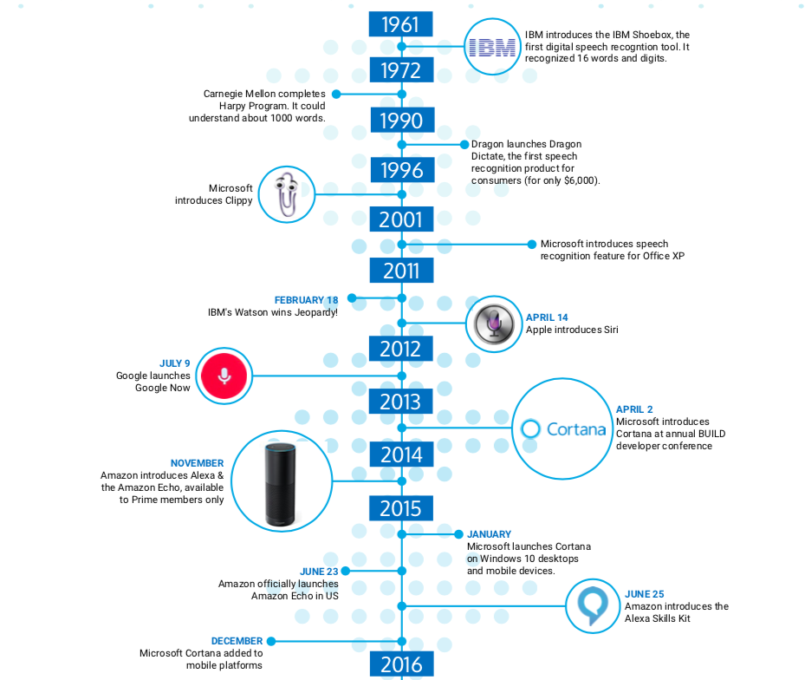
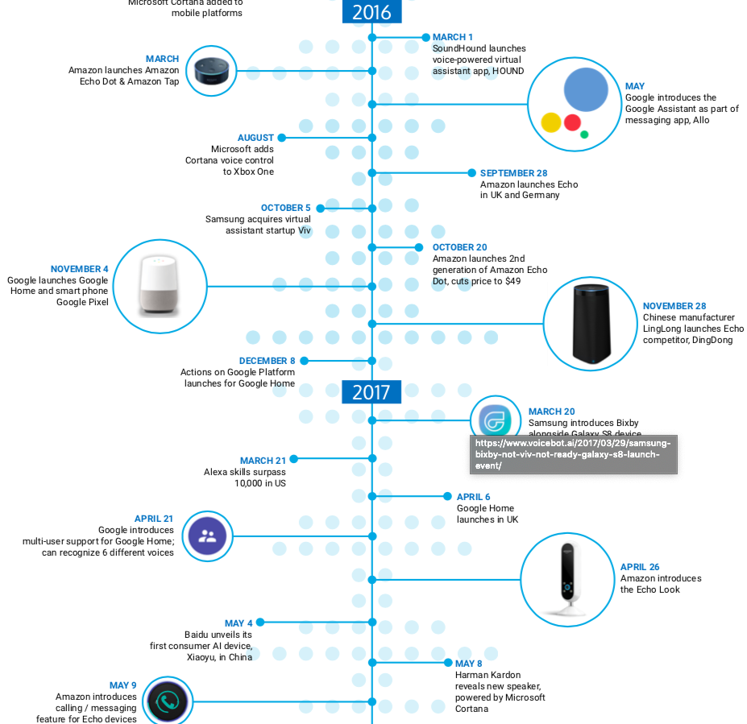

Slide 7
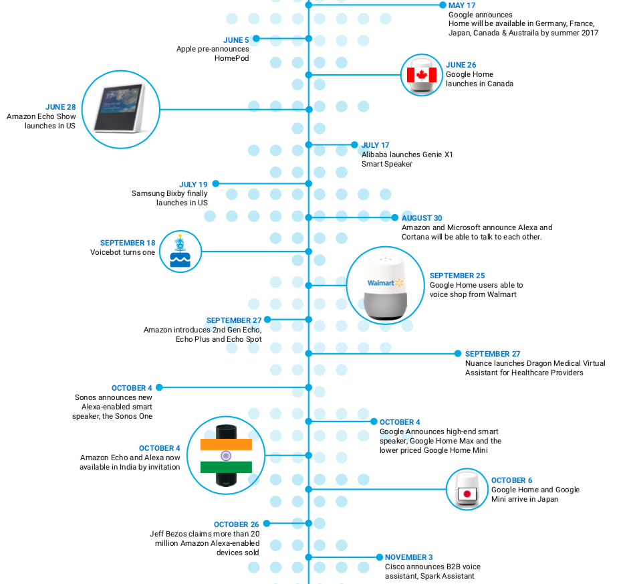
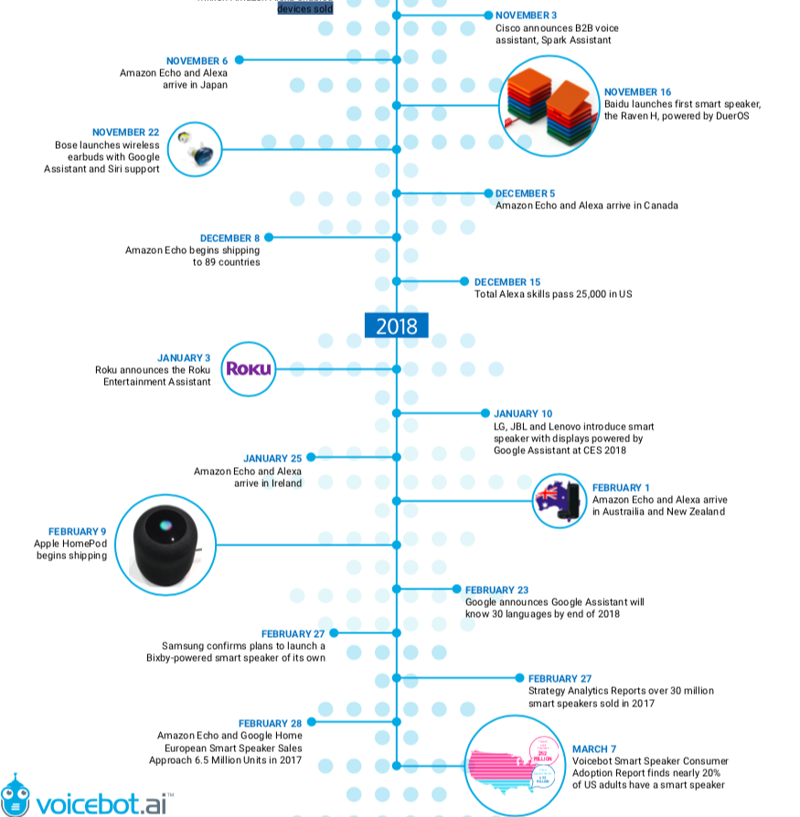

Slide 8
LITERATURE SURVEY

Slide 9
Basic Model of Speech Recognition
Simple probabilistic model of speech production
W , specified word sequence
Y , acoustic observation sequence
Probability P(W,Y)
Goal - decode the word string, based Y, so that the decoded string has the MAP probability
[1] Anusuya, M. A., and Shriniwas K. Katti. "Speech recognition by machine, a review." arXiv preprint arXiv:1001.2267 (2010).
[6] Khilari, Prachi, and V. P. Bhope. "A review on speech to text conversion methods." International Journal of Advanced Research in Computer Engineering & Technology 4.7 (2015).
Notes:
The standard approach to large vocabulary continuous speech recognition is to assume a simple probabilistic model of speech production whereby a specified word sequence, W, produces an acoustic observation sequence Y, with probability P(W,Y). The goal is then to decode the word string, based on the acoustic observation sequence, so that the decoded string has the maximum a posteriori (MAP) probability.

Slide 10
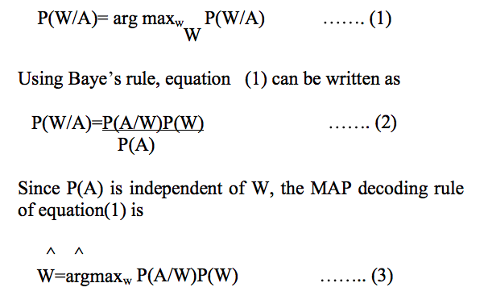
Basic Model of Speech Recognition
[1] Anusuya, M. A., and Shriniwas K. Katti. "Speech recognition by machine, a review." arXiv preprint arXiv:1001.2267 (2010).
[6] Khilari, Prachi, and V. P. Bhope. "A review on speech to text conversion methods." International Journal of Advanced Research in Computer Engineering & Technology 4.7 (2015).
Notes:
The first term in equation (3) P(A/W), is generally called the acoustic model, as it estimates the probability of a sequence of acoustic observations, conditioned on the word string. Hence P(A/W) is computed.
For large vocabulary speech recognition systems, it is necessary to build statistical models for sub word speech units, build up word models from these sub word speech unit models and then postulate word sequences and evaluate the acoustic model probabilities via standard concatenation methods
The second term in equation (3) P(W), is called the language model. It describes the probability associated with a postulated sequence of words.

Slide 11
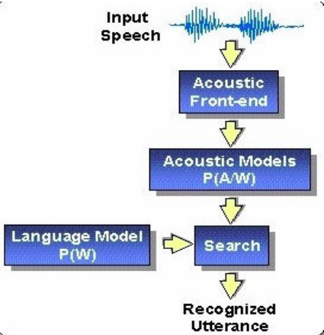
Basic Model of Speech Recognition
P(A/W), is generally called the acoustic model
P(W), is called the language model
[1] Anusuya, M. A., and Shriniwas K. Katti. "Speech recognition by machine, a review." arXiv preprint arXiv:1001.2267 (2010).

Slide 12
ASR
Analyze the performance of Automatic Speech Recognition (ASR) in different emotional environments using prosody modiﬁcation.
Prosody modification is done at the preprocessing level to convert the emotional utterance into neutral utterance, and the MFCC features are extracted later for ASR system.
[2] “Application of prosody modiﬁcation for Speech Recognition in different Emotion conditions”,V. V. Vidyadhara Raju, P. Gangamohan, Suryakanth V Gangashetty, and Anil kumar Vuppala

Slide 13
SUPPORT VECTOR MACHINE(SVM)
powerful tools for pattern recognition that uses a discriminative approach
It is a generalized linear classifier with maximum-margin fitting functions.
SVM controls the model complexity by controlling the VC dimensions of its model
ADVANTAGES
This method is independent of dimensionality and can utilize spaces of very large dimensions spaces.
By shifting all non-linearity to the features, SVM can use linear model for which VC dimensions is known.
[3] R.K.Moore, “Twenty things we still don t know about speech” Proc.CRIM/ FORWISS Workshop on Progress and Prospects of speech Research an Technology , 1994.

Slide 14
Drawbacks of Existing System
The existing systems are High compute requirement systems and mostly relies on Internet API calls to run which have requirement of internet connection which is a major fault of losing connectivity at critical situations.
Time Costs and Productivity
Accents and Speech Recognition
Deep Speech outperforms previously published methods on the Switchboard Hub5’00 corpus, achieving 16.0% error, and performs better than commercial systems

Slide 15
Drawbacks of Existing System
Traditional speech systems use many heavily engineered processing stages, including specialized input features, acoustic models, and Hidden Markov Models (HMMs).
Requires each user to train software to recognize voice.
Proposed system achieves a word error rate of 19.1% where the best commercial systems achieve 30.5% error

Slide 16
PROPOSED SYSTEM
Proposed project is a model to synthesise natural speech as processed output from input voice.The Input speech is converted to Text which is then syntactically and semantically processed to analyse the requirement and to generate the required action/statement and output is converted back to speech.

Slide 17
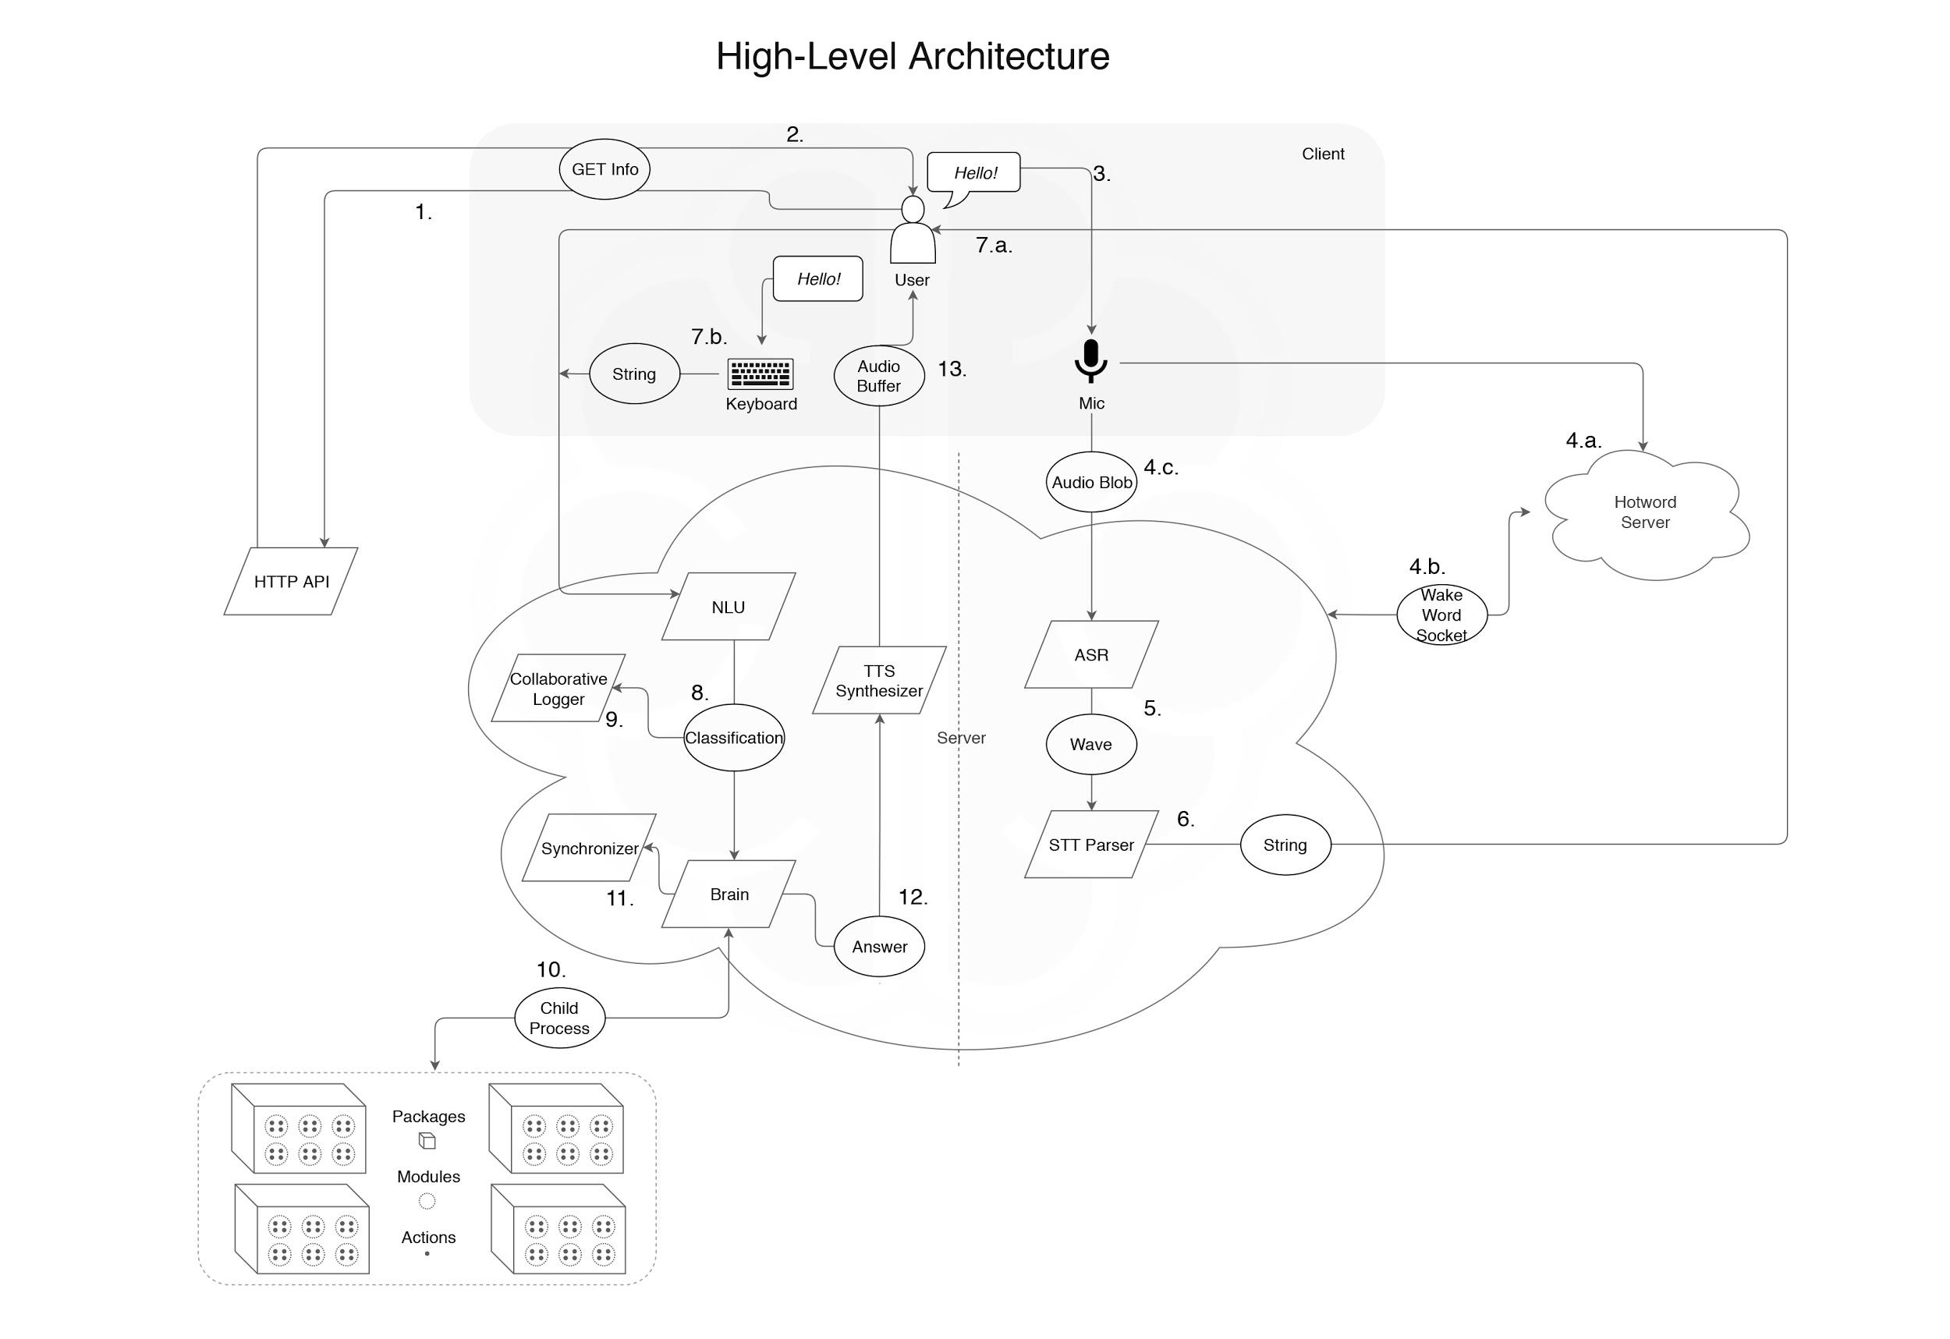

Slide 18
PROPOSED SYSTEM
Client (web app, etc.) makes an HTTP request to GET some information about Leon.
HTTP API responds information to client.
User talks with their microphone.
.
a. If hotword server is launched, Leon listens (offline) if user is calling him by saying Leon.
b. If Leon understands user is calling him, Leon emits a message to the main server via a WebSocket. Now Leon is listening (offline) to user.
c. User said Hello! to Leon, client transforms the audio input to an audio blob.
ASR transforms audio blob to a wave file.
STT parser transforms wave file to string (Hello).

Slide 19
PROPOSED SYSTEM
.
a. User receives string and string is forwarded to NLU.
b. Or user type Hello! with their keyboard (and ignores steps 1. to 7.a.). Hello! string is forwarded to NLU.
NLU classifies string and pick up classification.
If collaborative logger is enabled, classification is sent to collaborative logger.
Brain creates a child process and executes the chosen module.
If synchronizer is enabled and module has this option, it synchronizes content.
Brain creates an answer and forwards it to TTS synthesizer.
TTS synthesizer transforms text answer (and send it to user as text) to audio buffer which is played by client.

Slide 20
Modules
STT
Brain
TTS

Slide 21
Speech To Text(STT)
Speech-to-text is a type of speech recognition program that converts spoken to written language.
In this system we have implemented speech to text using RNN training setup.

Slide 22
RNN training setup
The goal of our RNN is to convert an input sequence x into a sequence of character probabilities for the transcription y, with y_{t} = P(ct|x), where ct ∈ {a,b,c,...,z,space,apostrophe,blank}.
Proposed RNN model is composed of 5 layers of hidden units. For an input x, the hidden units at layer l are denoted h(l) with the convention that h(0) is the input.
The first three layers are not recurrent. For the first layer, at each time t, the output depends on the spectrogram frame xt along with a context of C frames on each side

Slide 23

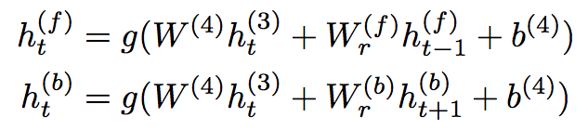
The remaining non-recurrent layers operate on independent data for each time step. Thus, for each time t, the first 3 layers are computed by:
The fourth layer is a bi-directional recurrent layer .This layer includes two sets of hidden units: a set with forward recurrence,
h(f), and a set with backward recurrence h(b)
:
The fifth (non-recurrent) layer takes both the forward and backward units as inputs
The output layer is a standard softmax function that yields the predicted character probabilities for each time slice t and character k in the alphabet

Slide 24
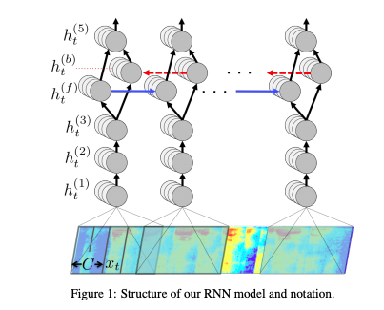

Slide 25

N-gram language model
Sample N-gram model transcription
[4] Hannun, Awni, et al. "Deep speech: Scaling up end-to-end speech recognition." arXiv preprint arXiv:1412.5567 (2014).

Slide 26

Sample Output (US English)

Slide 27
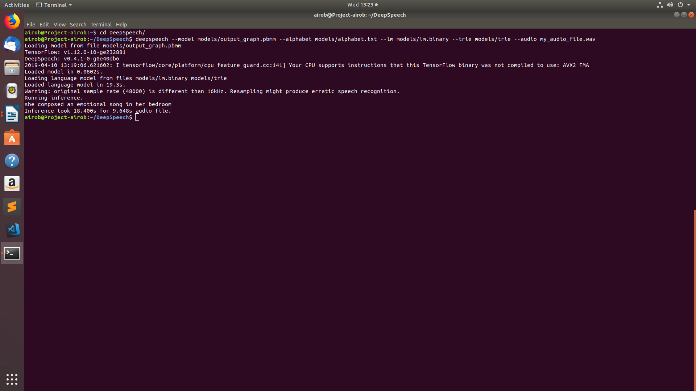

Slide 28
Sample Output (English with noise-Locally created)

Slide 29


Slide 30
BRAIN

Slide 31
Brain creates a child process and executes the chosen module.
If synchronizer is enabled and module has this option, it synchronizes content.
Brain creates an answer and forwards it to TTS synthesizer.
TTS synthesizer transforms text answer (and send it to user as text) to audio buffer which is played by client.

Slide 32
Text To Speech(TTS)

Slide 33
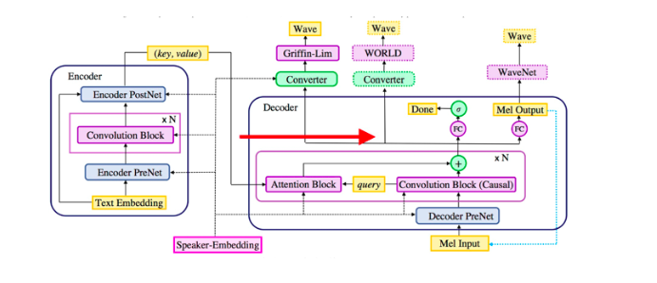
TEXT TO VOICE SYSTEM
DEEP VOICE MODEL
Notes:
The encoder network (depicted in Fig. 1) begins with an embedding layer, which converts characters or phonemes into trainable vector representations, he.These embeddings are first projected via a fully-connected layer from the embedding dimension to a target dimensionality.extract time-dependent text information
The decoder (depicted in Fig. 1) generates audio in an autoregressive manner by predicting a group of r future audio frames conditioned on the past audio frames. Since the decoder is autoregressive, it must use causal convolution blocks.
Griffin-Lim vocoder: Griffin-Lim algorithm converts spectrograms to time-domain audio waveforms by iteratively estimating the unknown phases.
WORLD vocoder: The WORLD vocoder is based on (Morise et al., 2016). As vocoder parameters, we predict a boolean value (whether the current frame is voiced or unvoiced), an F0 value (if the frame is voiced)
WaveNet vocoder: We separately train a WaveNet to be used as a vocoder treating mel- scale log-magnitude spectrograms as vocoder parameters.

Slide 34
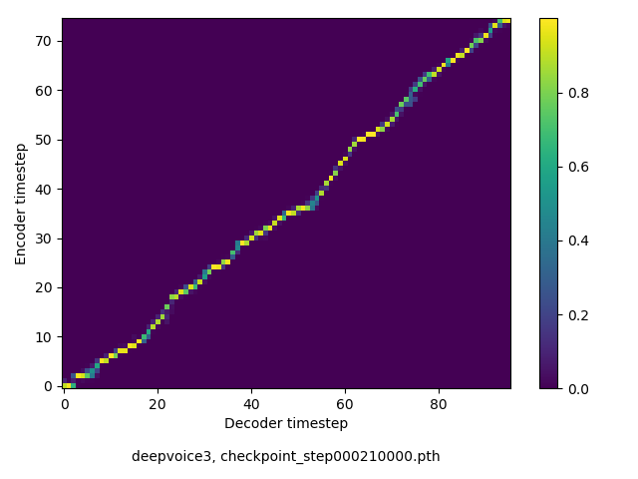
Sample Output
Scientists at the CERN laboratory say they have discovered a new particle.

Slide 35
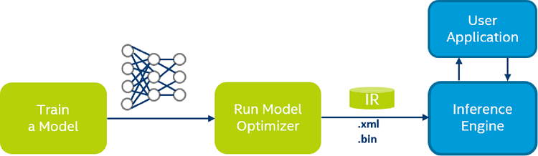
Optimisation (OpenVino model Optimizer)

Slide 36
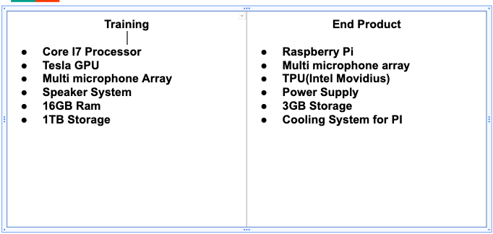
HARDWARE AND SOFTWARE
System Requirement

Slide 37
Benefits from others
Fast training.
Attention error mode: will not detect repeated words,mispronunciations,skipped words etc
Naturalness : trained as human voice using modulation.
Highly optimized.
Limited training data.

Slide 38
FUTURE SCOPE AND VISION
Optimise the system changing the extracted parameters and the RNN model.
Create Regional Dataset of Speech to ensure proper detection of local slangs.
Optimise the model further utilising intel optimising tools such as OpenVino,

Slide 39
SYSTEM DEMO
Attached to the page

Slide 40
Development supports from external organisations
STT -Deep Speech model -Supported by Mozilla and baidu deep speech research centre china
Brain model- Supported by Intel software.
TTS - Deep Voice model- Supported by Intel software and IISC bangalore

Slide 41
REFERENCES
[1] “Anusuya, M. A., and Shriniwas K. Katti. "Speech recognition by machine, a review." arXiv preprintarXiv:1001.2267 (2010).Khilari, Prachi, and V. P. Bhope. "A review on speech to text conversion methods." International Journal of Advanced Research in Computer Engineering & Technology 4.7 (2015).
[2] “ Application of prosody modiﬁcation for Speech Recognition in different Emotion conditions”,V. V. Vidyadhara Raju, P. Gangamohan, Suryakanth V Gangashetty, and Anil kumar Vuppala
[3] R.K.Moore, “Twenty things we still don t know about speech” Proc.CRIM/ FORWISS Workshop on Progress and Prospects of speech Research an Technology , 1994.
[4] Hannun, Awni, et al. "Deep speech: Scaling up end-to-end speech recognition." arXiv preprint arXiv:1412.5567 (2014).
[5] Ping, Wei, et al. "Deep voice 3: Scaling text-to-speech with convolutional sequence learning." (2018)

Slide 42
REFERENCES
[6] Khilari, Prachi, and V. P. Bhope. "A review on speech to text conversion methods." International Journal of Advanced Research in Computer Engineering & Technology 4.7 (2015).

